Slide 1
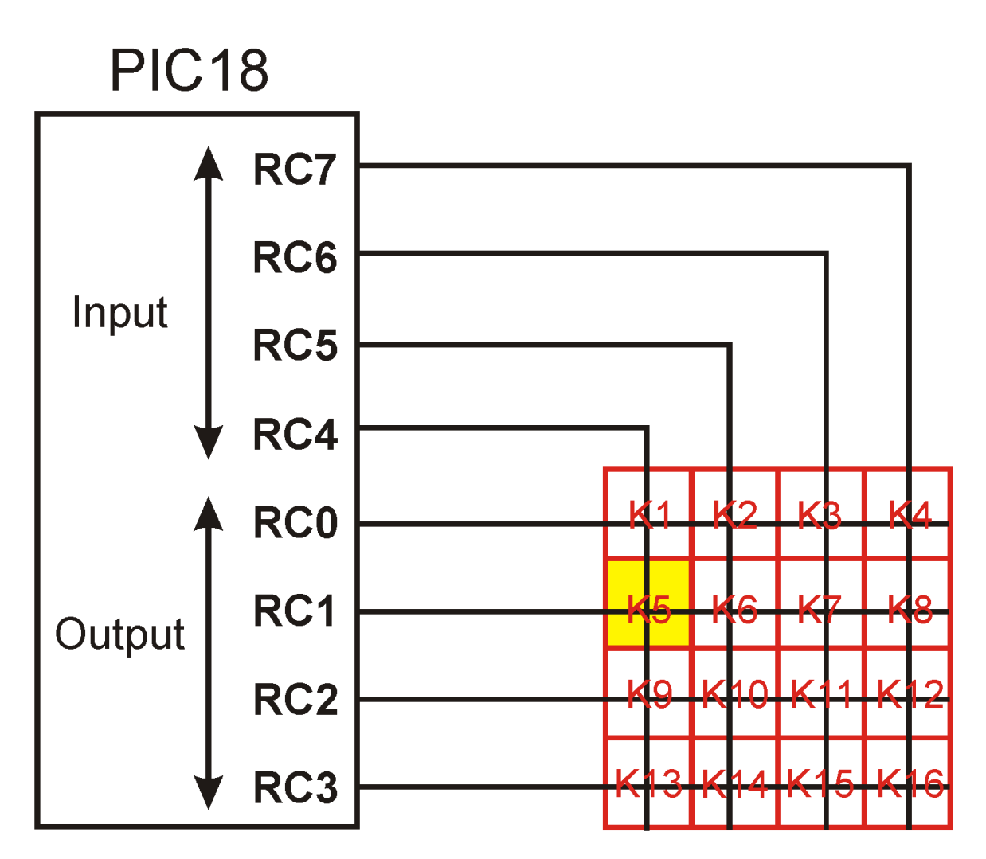
When K5 is pressed
1
1
1
0
1
0
1
1
0
1
1

Slide 2
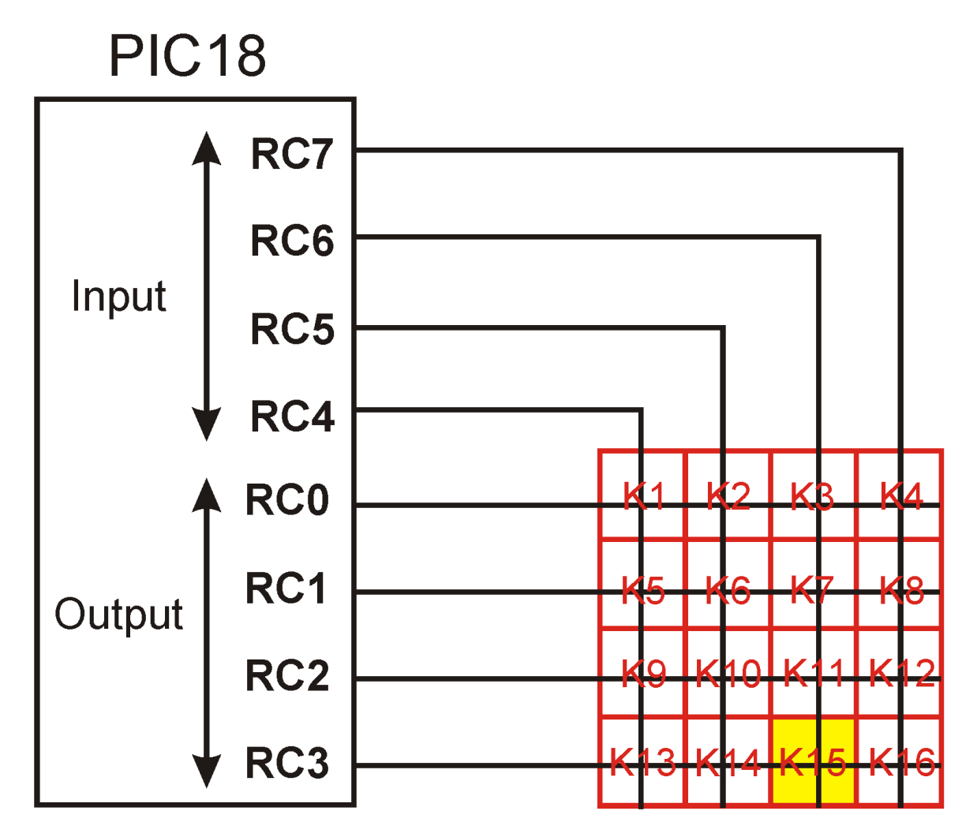
When K15 is pressed
1
1
1
0
1
0
1
1
0
0
1
1
0

